Slide 1


Enhancing Job Matching and Market Analysis through NLP
A comprehensive approach using Natural Language Processing to revolutionize job matching and market insights.
Notes:
Hi, everyone. Today, I'm excited to share my project on 'Enhancing Job Matching and Market Analysis through NLP.' This project represents a significant step forward in leveraging technology to connect job seekers with the right opportunities and provide valuable insights into the job market.

Slide 2

Business Problem
Addressing the challenge of efficiently matching job seekers with relevant positions in a vast and dynamic job market by leveraging NLP.
Notes:
In the current job market, both job seekers and employers face the challenge of finding the right match among a vast array of opportunities and candidates. Traditional methods often rely on simplistic keyword matching, which can overlook the complexities of job roles and candidate capabilities.

Slide 3

Background/History
Traditional job matching processes have relied on simplistic keyword matching, often overlooking the complexities and nuances of job roles and candidate capabilities. The advent of NLP offers a promising solution to these limitations.
Notes:
Traditionally, job matching has been a manual and often imprecise process. With the advent of NLP, we have the opportunity to significantly improve how we analyze job data. By understanding the nuances in job descriptions and resumes, we can make more accurate and meaningful matches.

Slide 4
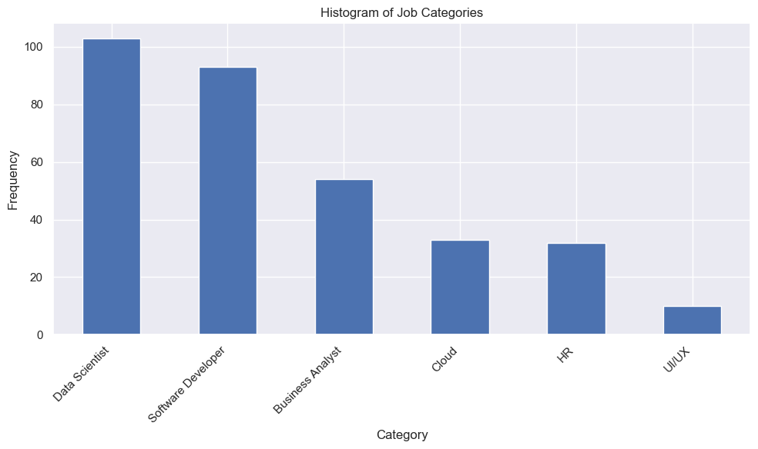
Data Explanation
The project utilizes a Kaggle dataset with job descriptions, categories, benefits, and requirements. Data preparation involved cleaning, merging text features, and preprocessing for analysis.
Notes:
Our project utilizes a rich dataset from Kaggle, comprising job descriptions, categories, benefits, and requirements. We undertook a comprehensive data preparation process, including cleaning, merging text features, and preprocessing to ensure our analysis was on a solid foundation. The data source include 324 records with about 100 for data science category HR and UIUX having the least records

Slide 5
Methods
Employing TF-IDF vectorization to transform text data into numerical format, followed by the Multinomial Naive Bayes classifier to categorize job postings. Hyperparameter tuning was conducted to optimize model performance.
Notes:
We employed TF-IDF vectorization to transform the text data into a numerical format that our models could work with. We then applied the Multinomial Naive Bayes classifier, an effective algorithm for text classification, to categorize job postings. Hyperparameter tuning was conducted to refine our model further. We also test the LSTM model but the out put is not optimistic with only 15% accuracy

Slide 6
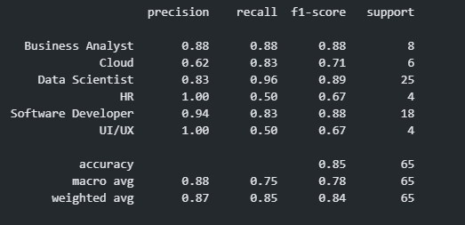
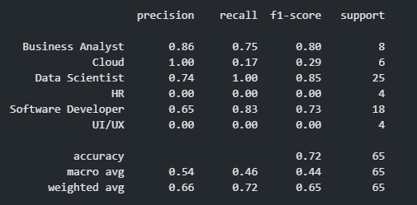
Analysis
The model demonstrated varying performance across different job categories, with significant success in some and room for improvement in others. A detailed classification report provided insights into model precision, recall, and f1-scores.
Notes:
Our analysis revealed insightful patterns and variations in model performance across different job categories. We achieved high precision and recall in some categories, indicating strong model performance, while identifying areas for improvement in others. This detailed analysis has been instrumental in understanding our model's strengths and areas for enhancement.
After tuning hyper parameter for our model. The result was improved a lot for HR UIX software developer and Data scientist.

Slide 7
Conclusion & Future Scope
NLP techniques significantly enhance job matching algorithms and market analysis, offering a more nuanced understanding and classification of job postings. The approach shows promise for improving recruitment processes and market insights.
Exploring advanced NLP models, expanding the dataset, addressing class imbalance, and continuous monitoring for bias and performance. Integration into real-world job matching platforms for further testing and refinement.
Notes:
The application of NLP techniques in this project has not only enhanced job matching algorithms but also provided deeper insights into market trends. It's clear that NLP holds great promise for transforming the recruitment process and providing valuable market intelligence.
Looking ahead, we plan to explore more advanced NLP models, expand our dataset, and implement strategies to address class imbalance. Our goal is to integrate these improvements into real-world job matching platforms for further testing and refinement.
In closing, it's important to acknowledge the ethical considerations in using AI for job matching. We're committed to ensuring data privacy, mitigating bias, and maintaining transparency in our models to build trust among all stakeholders.

Slide 8

Thank you
Notes:
Thank you for your attention. We believe that by advancing our work in NLP, we can make significant strides in connecting people with the right opportunities and unlocking new insights into the labor market. I look forward to your questions and further discussions.

